Slide 1

Interpretable Machine Learning for Customer Churn Prediction and Segmentation for Telecom
Tianyu Wang, Joseph L. Tsenum , Xiaofang Liu, Saaliha Allauddin Khan Ghori, Shreya Punjabi (Group 48)
Notes:
Our project for this semester focuses on using ML for customer churn prediction and segmentation for telecommunication

Slide 2

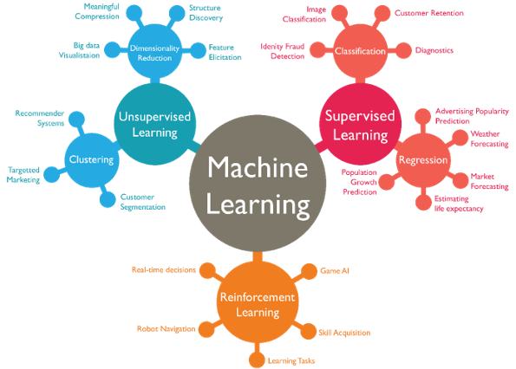
Introduction/Background
Past research has explored a variety of feature selection techniques:
Principal Component Analysis (PCA)
Information gain, and Linear Discriminant Analysis (LDA)
Numerous studies have engaged machine learning algorithms:
Decision Trees
Random Forests
Support Vector Machines (SVM)
Our project is committed to precisely predicting customer attrition through the utilization of interpretable ML approaches, with a focused effort on efficiently classifying customers in the telecommunications industry.
Notes:
Several kinds of research have been conducted to determine customer attrition. Some of the most common feature selection techniques used in these researches include PCA and LDA, and common ML algorithms include decision trees, random forests, and SVM. Our project is committed to precisely predicting customer attrition using some of these techniques and algorithms.

Slide 3
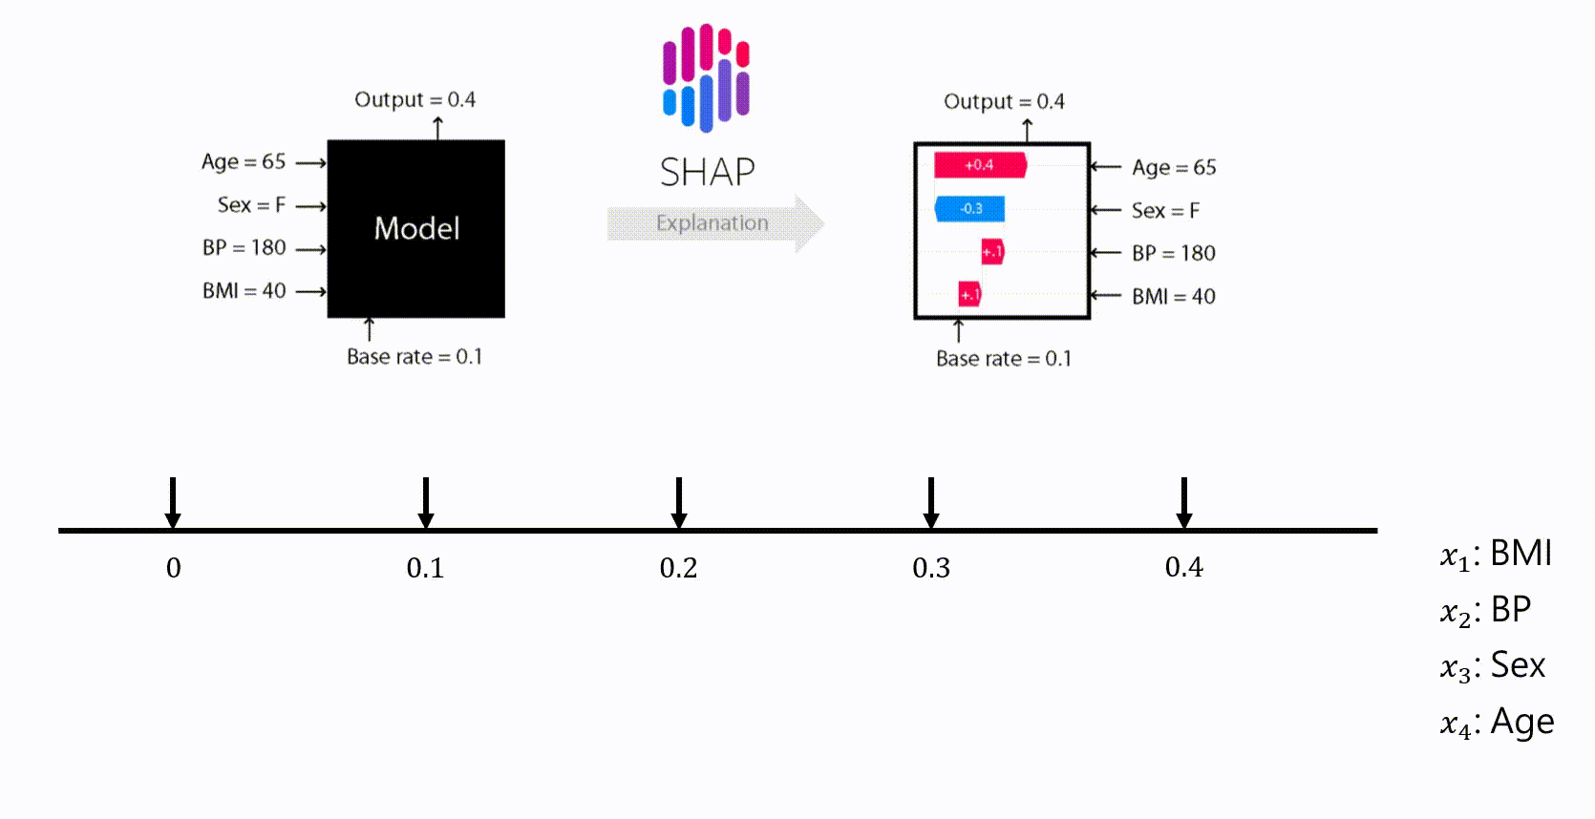
Problem Definition
Traditional machine learning models, such as black-box models like deep learning or ensemble methods, may provide accurate predictions but lack interpretability.
This means that it is difficult to understand and explain why a particular prediction or segmentation decision was made.
SHAP (Shapley Additive Explanations) machine learning, on the other hand, provides explanations for the predictions or segmentation outcomes.
It assigns importance shapley values to each feature, indicating their contribution towards the final prediction or segmentation decision.
Courtesy: https://medium.com/@evertongomede/shapley-additive-explanations-unveiling-the-black-box-of-machine-learning-477ba01ffa07
Notes:
The traditional and existing ML models may provide accurate predictions but lack interpretability, which makes it difficult to understand and explain prediction and segmentation decisions. Using SHAP which provides explanations for the predictions and segmentation outcomes, we can easily understand each features contribution to the final decision.

Slide 4
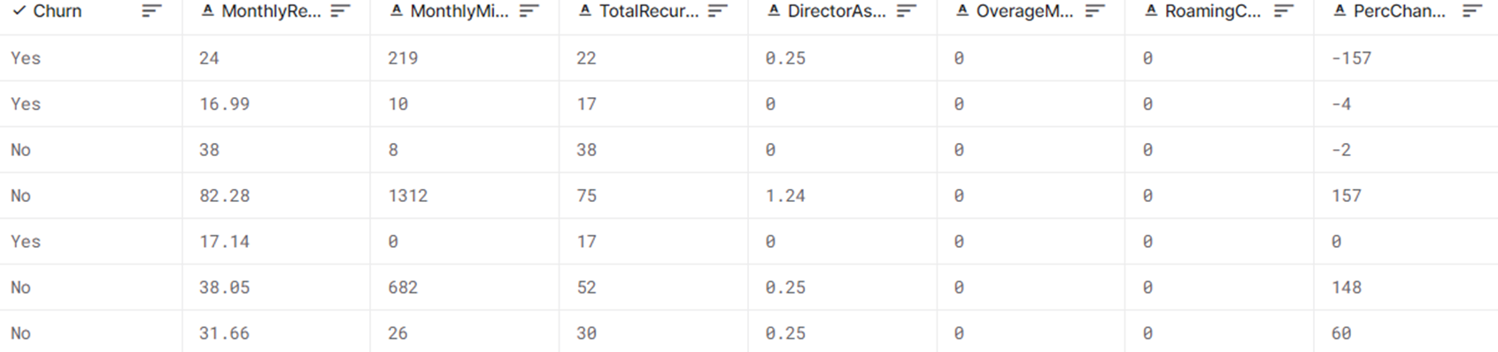
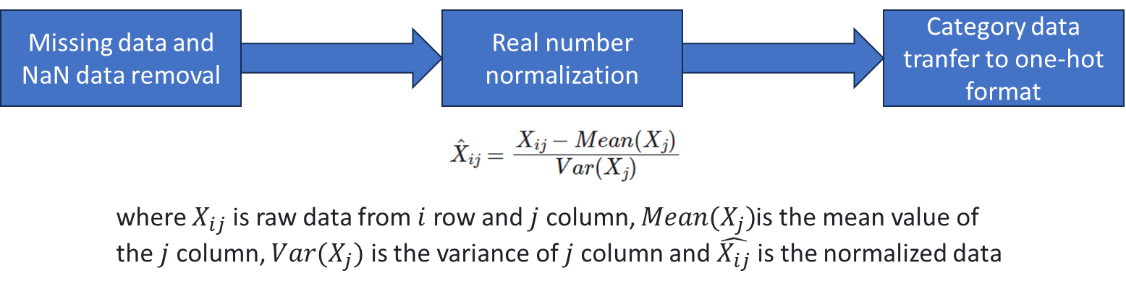
Methods
Notes:
For the methods, a clean data will be created by removing missing and NaN data. Then using the real number normalization formula, the normalized data is created. Then, the data is transferred to one-hot format.

Slide 5
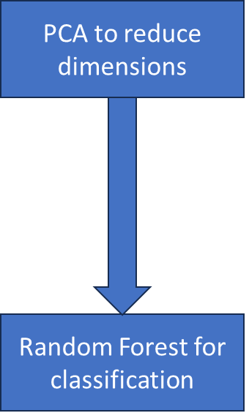
Methods
PCA: With the principal features and their weights, the topmost principal features that counts for more than 85% in sum are selected.
Random Forest and SVM model: Applied on classification problem in churn prediction, which are popular and robust supervised learning methods.
Alternatively, we will also try MLP and K-Means Clustering model to classify customer segmentation. These are popular and robust unsupervised learning approaches.
Notes:
Furthermore, using PCA algorithm which comes under unsupervised learning is used to reduce the dimensions the data. Then, supervised learning models, random forest model and SVM model is applied on this data to classify whether the customers will churn. Alternatively, for customer segmentation, unsupervised learning models, MLP and K-means clusterning will be used.

Slide 6
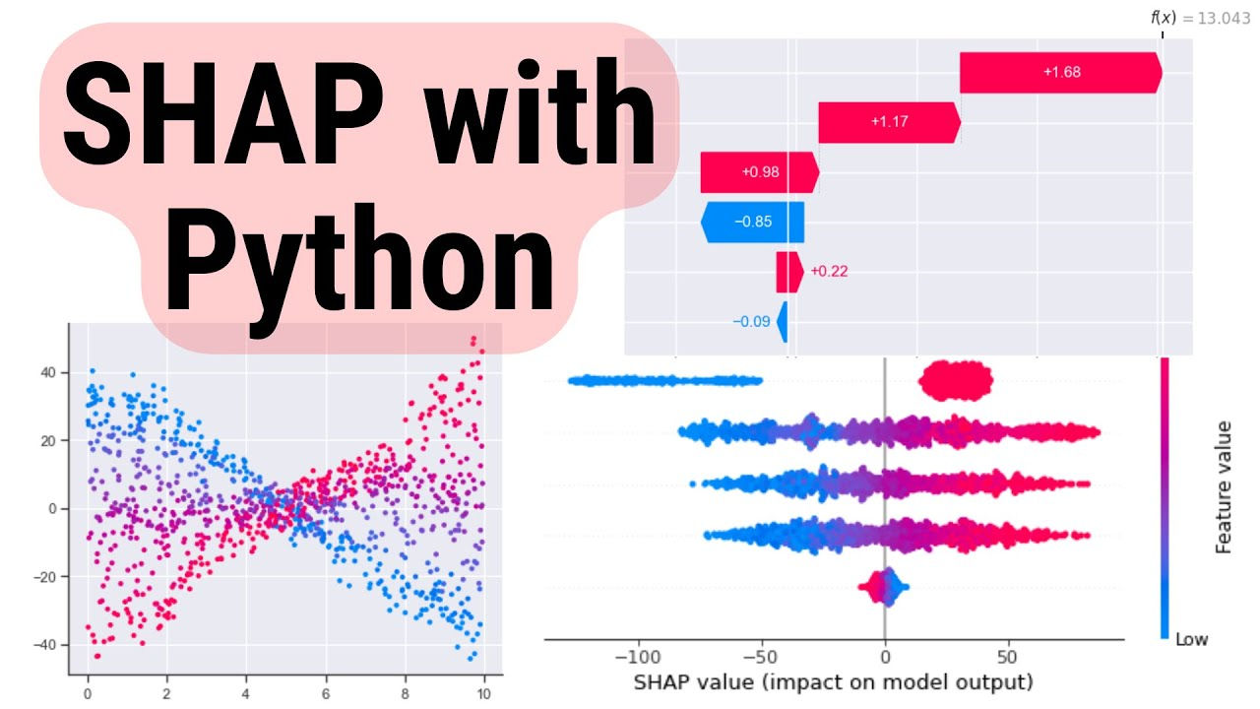
Potential Results and Discussion
Before using SHAP for model interpretability, we shall be using ROC curve (a receiver operating characteristic curve) to test our black-box model performance for our classification task.
The expected SHAP results in telco customer churn prediction and customer segmentation would provide insights into the importance and impact of different features on the prediction or segmentation outcome.
This information can help telcos understand the key drivers behind churn and prioritize their retention efforts accordingly.
The SHAP values can highlight the specific features that contribute positively or negatively to the churn prediction, providing a clear understanding of the factors influencing customer churn.
Courtesy: Introduction toSHAP with Python. How to create and interpret SHAP plots… | by Conor O'Sullivan | Towards Data Science
Notes:
Moving on to the results and discussion. The ROC curve will be used to test the performance of our black-box model for our classification task. Then SHAP will be used for model interpretability. The results gained from SHAP will provide insights into the importance and impact of different features on the prediction or segmentation outcome.
This information will assist telecom companies understand the drivers behind churn and prioritize their retention efforts accordingly.

Slide 7
Thank you!

